Slide 1

BACHELOR OF TECHNOLOGY
IN
Artificial Intelligence and Machine Learning
Batch Number: ZT-5
Project Guide: DR Omkar Lakshmi Jagan Batch Names & Roll Numbers:
Srinidhi : 2111cs020546
Guru Bharath: 2111cs020548
Sri Charan: 2111cs020549
Surya Prakash:2111cs020550
Department of AIML, School of Engineering
Malla Reddy University

Slide 2
Contents
1.INTRODUCTION 4.DEPLOYEMENT & RESULTS
PROBLEM STATEMENT SOURCE CODE
SCOPE MODEL IMPLMENTATION & TRAINING
OBJECTIVES MODEL EVALUATION & METRICS
2.ANALYSIS MODEL DEPLOYEMENT
PROJECT PLANNING AND RESEARCH RESULTS
SOFTWARE&HARDWARE REQURIEMENTS
MODEL SELECTION & ARCHITECTURE 5.CONCLUSION
3.DESIGN PROJECT CONCLUSION
FUTURE WORK
DATASET DESCRIPTION REFRENCES
WORKING PROJECT
ALGORITHIMS USED

Slide 3
Problem Statement:
Developing an accurate and cost-effective deep learning model for classifying skin diseases caused by bacteria and fungi using non- dermoscopic images. The dataset includes five classes: Cellulitis, Impetigo (bacterial skin diseases), Ringworm, Sporotrichosis (fungal skin diseases), and Healthy Skin. Leveraging transfer learning with the fine-tuned VGG16 architecture, the goal is to achieve high accuracy (87%) and an F1-score of 85%. This model will enhance dermatologists’ decision-making process, reduce diagnosis time, and minimize costs associated with skin disease diagnosis.

Slide 4
SCOPE:
The scope, the project ensures a structured approach to achieving its goals, maximizing the chances of developing a successful, practical, and impactful deep learning model for skin disease classification.
Medical Education: Providing tools for medical students and professionals to learn about skin diseases and diagnostic techniques.
Public Awareness: Educating the public about skin health and the importance of early diagnosis.
Early Diagnosis: Developing deep learning models to detect and classify skin diseases early, improving treatment outcomes.
Decision Support Systems: Assisting dermatologists in diagnosing and treating skin diseases by providing a second opinion.

Slide 5
OBJECTIVES:
The project is to classify the type of disease using deep learning. In order to decide, these algorithms employ feature values from effected images as input. Three parts make up the process of determining the type of skin disease: feature extraction, training, and testing.
The objective is to increase the accuracy of diagnosis for various types of skin diseases. The process makes use of deep learning technology to train itself with the various skin images.
Three important features in image classification are texture, color, shape, and combination of these. In this project work, features such as entropy, variance, contrast, and energy are used to build machine learning algorithm such as CNN, and Decision Tree. Accuracy is used to test the performance of the chosen algorithms.

Slide 6
ANALYSIS: PROJECT PLANNING AND RESEARCH:
The project planning involves several key phases: initial research and planning to understand existing methodologies; data collection and preparation, including gathering and annotating a dataset of non-dermoscopic skin disease images; model development using deep learning architectures like CNNs; and validation and testing to ensure accuracy and robustness. Following this, the model will be deployed through user-friendly web and mobile applications, with integration into cloud infrastructure for scalability

Slide 7
SOFTWARE & HARDWARE REQURIEMENTS:
SOFTWARE REQURIEMENTS:
The software requirements for this project include deep learning frameworks such as TensorFlow or PyTorch for model development and training. A robust data processing and augmentation library like OpenCV or TensorFlow's data API is necessary for handling and preparing image data. For building the web and mobile applications, front-end technologies such as React or Angular and back-end frameworks like Flask or Django are essential.
HARDWARE RREQURIEMENTS:
1.Processor (intel core i5 CPU)
2.Memory(8GB)
3.Storage(512GB SSD or larger)

Slide 8
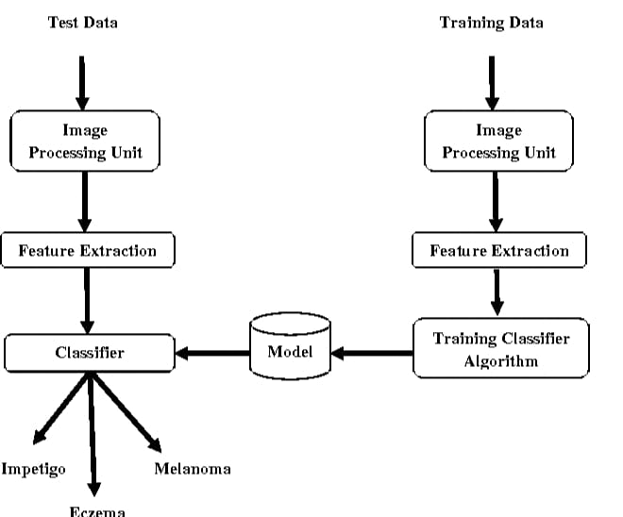
MODEL SELECTION AND ARCHITECTURE:

Slide 9
DESIGN : DATASET DESCRIPTION:
Image Type: Non-thermoscopic images captured in visible light spectrum.
Quality: High-resolution images suitable for medical diagnosis.
Size: Balanced distribution across categories to ensure effective model training.
Sources: Compiled from medical archives and clinics, ensuring accurate labelling and data quality.

Slide 10
ALGORITHMS & METHODS
Convolutional Neural Network (CNN) Input: The algorithm takes pre-processed training images as input. These images are represented as pixel values. The filters (kernels) consist of randomly initialized weights.
Forward Pass: The input images pass through convolutional layers and pooling layers. In each convolutional layer, the input image is convolved with filters. Pooling layers down sample the feature maps. Patterns and features are detected, resulting in feature maps.
Prediction: Feature maps are used to predict the image class. The predicted output is compared with the expected output to compute prediction error.
Backward Pass (Backpropagation):The backpropagation algorithm updates filter weights based on prediction error.
Forward and backward passes are repeated for multiple epochs. Optimal filter weights minimize prediction error.

Slide 11
WORKING OF PROJECT:
Convolutional Neural Networks (CNNs) form the backbone of the VGG16 model, enabling effective capture of intricate spatial features crucial for distinguishing between various skin conditions.
During training, the model is optimized using Stochastic Gradient Descent (SGD) with momentum and Categorical Cross-Entropy Loss, ensuring efficient parameter adjustment to minimize classification errors.
Evaluation metrics such as accuracy, precision, recall, and F1-score are employed to assess the model's performance on a validation set, ensuring robust generalization to unseen data.
Finally, the model is deployed using a web-based interface built with Flask or Fast API, enabling dermatologists to upload skin images for real-time classification

Slide 12
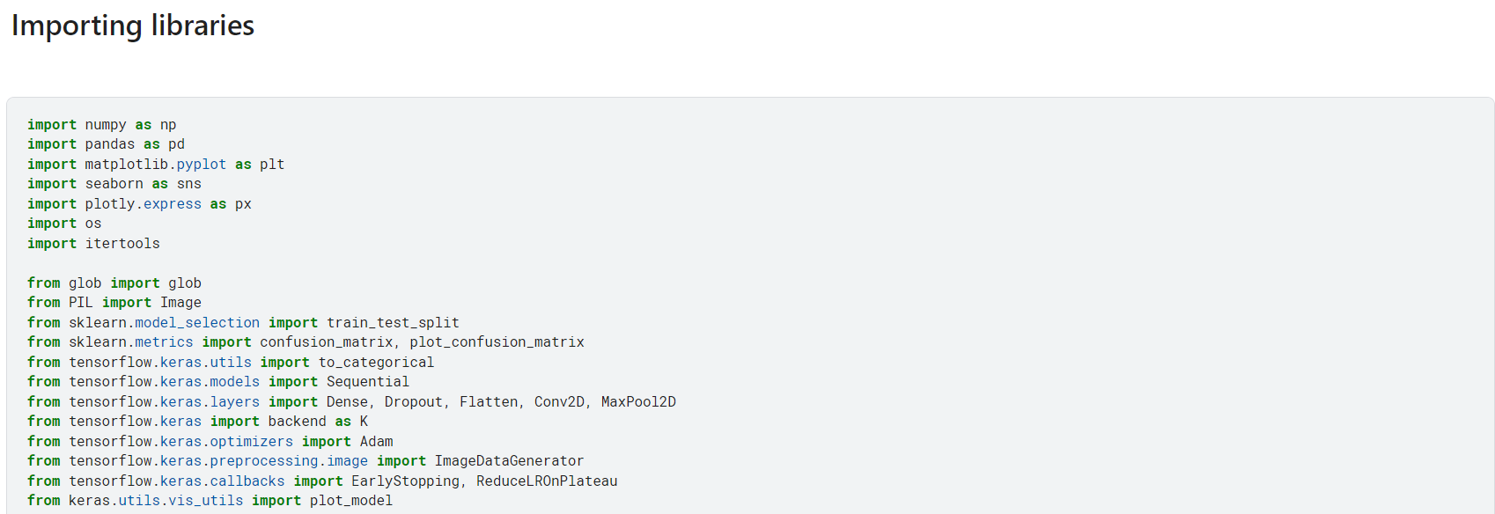
DEPLOYEMENT AND RESULTS:
SOURCE CODE:

Slide 13
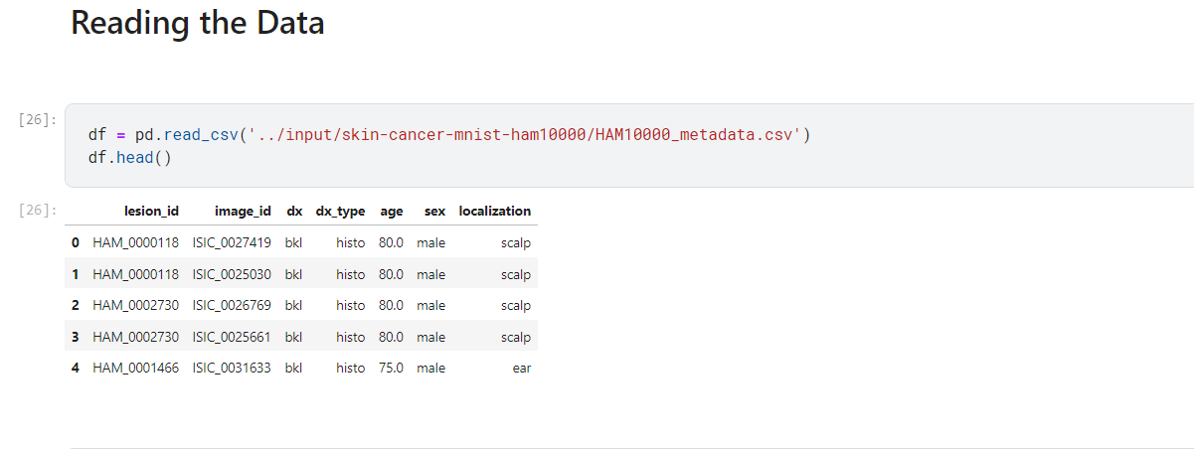
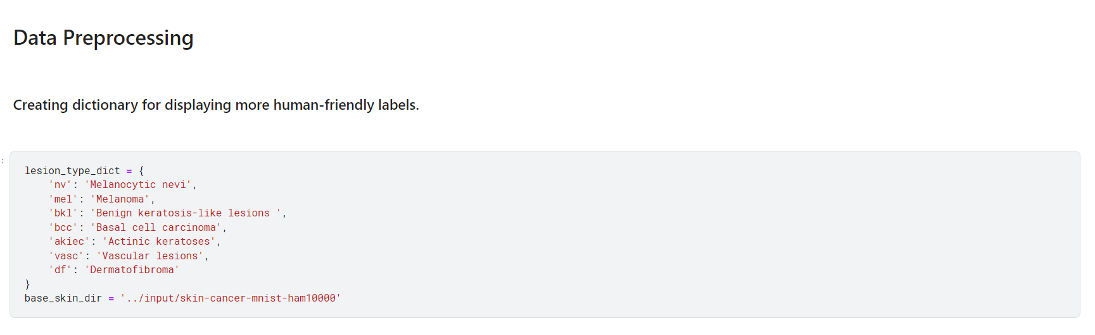
SOURCE CODE:

Slide 14
SOURCE CODE:

Slide 15
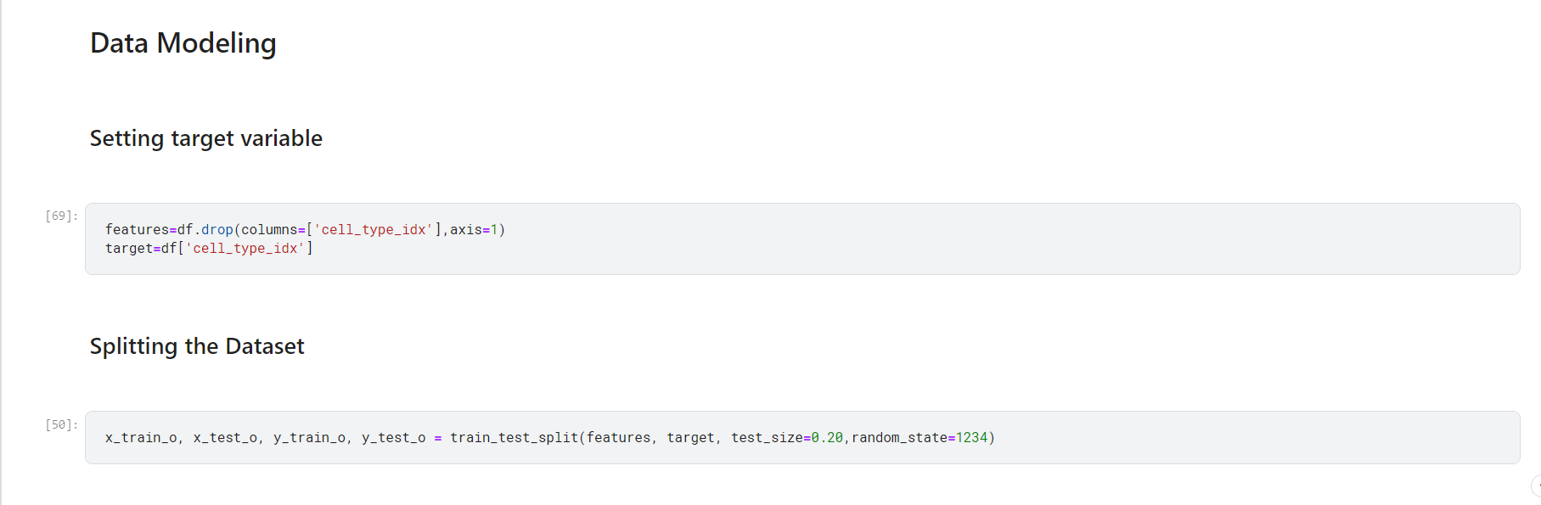
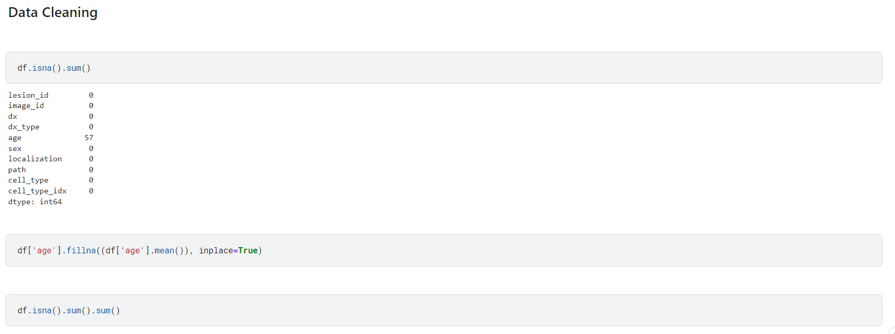
SOURCE CODE:

Slide 16
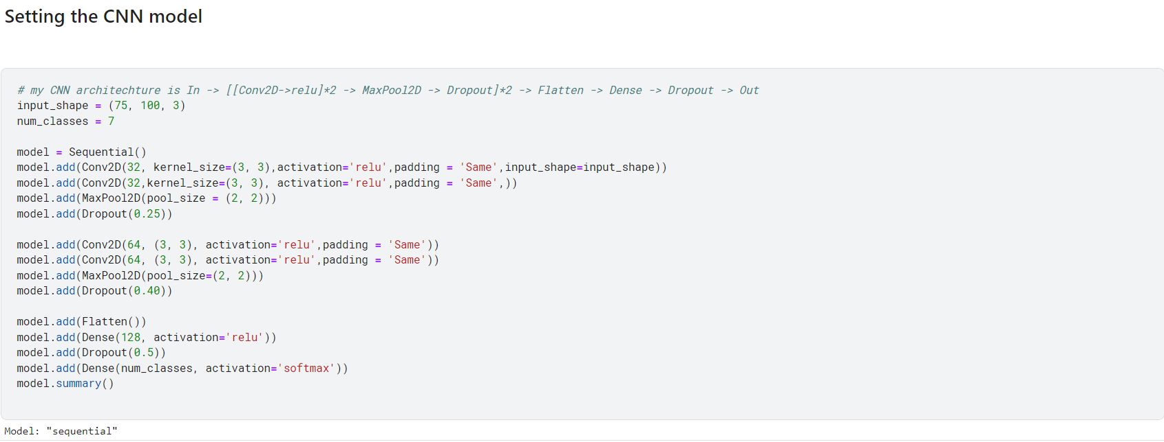
SOURCE CODE:

Slide 17
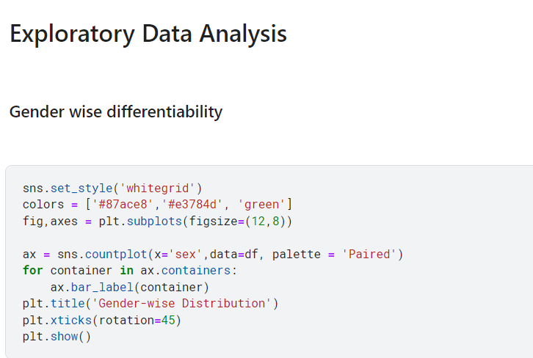
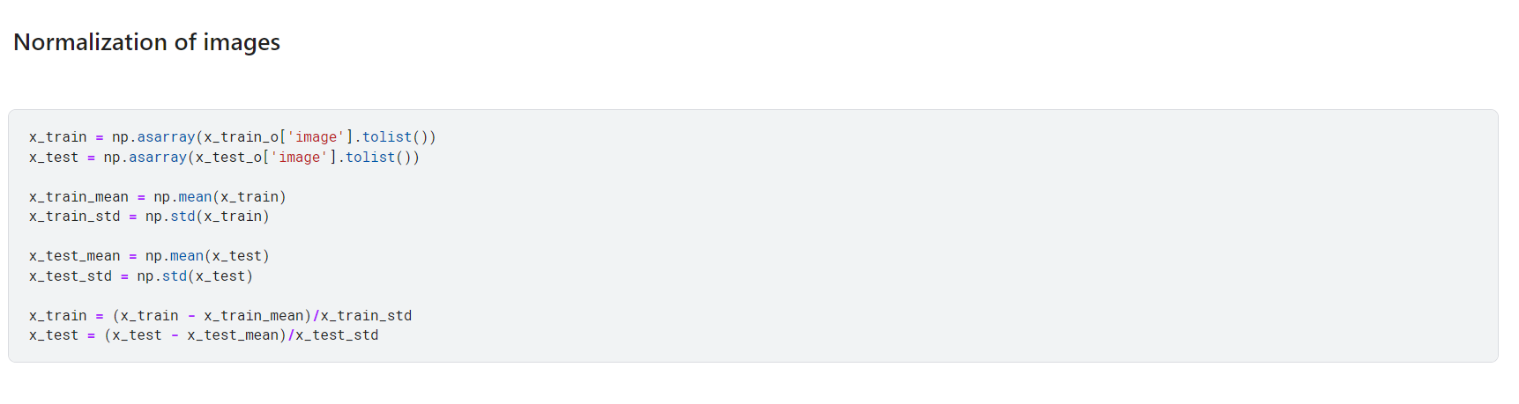
SOURCE CODE:

Slide 18
Model Implementation & Training
The implementation is carried out using the Python Programming language. The model is developed using the Kera's framework. The dataset is loaded by mounting the Google Drive to the Google Collab notebook. All the images are resized and class labels are encoded to integers. The dataset is split such that 80% of the dataset is used for training while 20% of the data is used for validation and testing. A stratified split is performed that forces the distribution of the classes among different splits to be the same. The training and testing images are normalized and then the class weights are computed.

Slide 19
Model Evaluation Metrices
Accuracy: The ratio of correctly classified images to the total number of images. It represents the overall model performance, but can be misleading for imbalanced datasets (where some classes have many more examples than others).
Precision: The ratio of correctly predicted positive cases (diseases) to the total number of predicted positive cases. It measures how good the model is at identifying true positives and avoiding false positives.
Recall: The ratio of correctly predicted positive cases (diseases) to the total number of actual positive cases. It measures how good the model is at finding all relevant cases (avoiding false negatives).
F1-score: The harmonic mean of precision and recall, combining both metrics into a single score. It provides a balanced view of a model's performance, especially for imbalanced datasets.

Slide 20
Model Deployment
Data Preparation: Images of various skin conditions and healthy skin are collected and labeled .
Model Development: A deep learning model (e.g., Convolutional Neural Network - CNN) is trained on the labeled data. The model learns to recognize patterns that differentiate different skin diseases.
Model Selection: A trained model with good performance (accuracy, precision, recall) is chosen for deployment.
Inference Engine: The model is converted to a format suitable for deployment on a target platform (e.g., mobile device, server-side application). This often involves optimization for speed and resource efficiency.
Integration: The inference engine is integrated into an application or service that captures skin images (e.g., mobile app camera) and feeds them to the model for classification.
Prediction: When a new image is presented, the model analyzes it and outputs a prediction for the most likely skin disease.

Slide 21
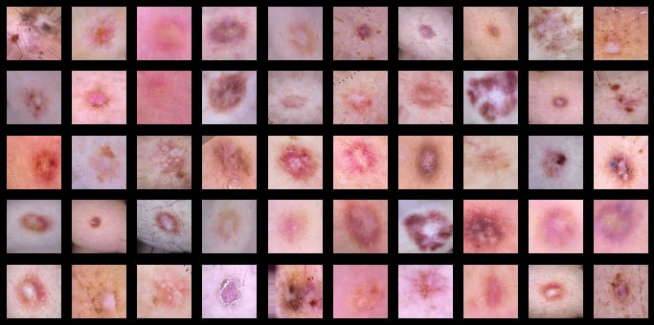
Final Result

Slide 22
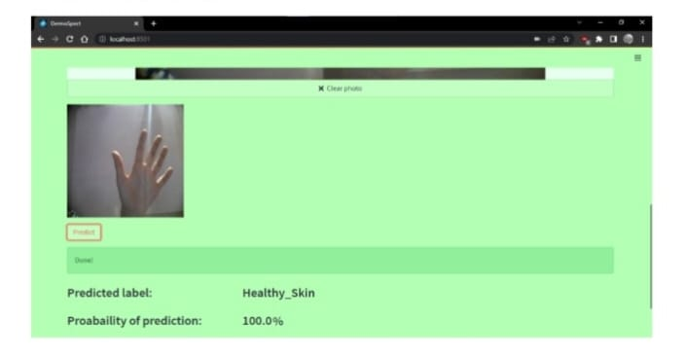

Slide 23
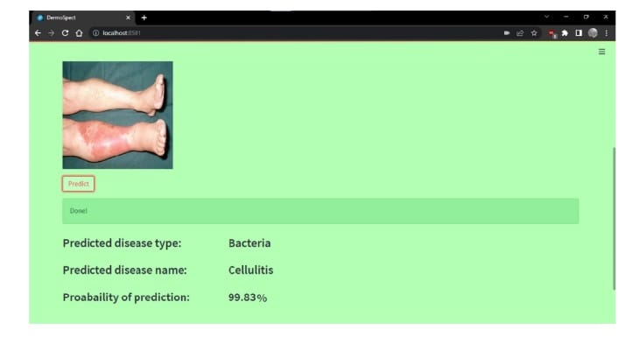

Slide 24
Conclusion
This deep learning model, using non-dermoscopic images and a fine-tuned VGG16 architecture, achieves 87% accuracy for skin disease classification.
The user-friendly web app allows image uploads and webcam capture, displaying predictions with probabilities.
This tool can aid dermatologists, improve diagnosis speed, and reduce costs.

Slide 25
Future Work
Integrate dermoscopic image support for broader applicability.
Implement multi-disease classification for more comprehensive diagnosis.
Refine the model with a larger and more diverse dataset for enhanced accuracy and generalizability.
Explore explainable AI techniques to provide insights into the model's reasoning and build trust in its predictions.

Slide 26
References:
1. Mohammed, Z. F., & Abdulla, A. A. (2021). An efficient CAD system for ALL cell identification from microscopic blood images. Multimedia Tools and Applications, 80(4), 6355-6368.
2. Li, L. F., Wang, X., Hu, W. J., Xiong, N. N., Du, Y. X., & Li, B. S. (2020). Deep Learning in Skin Disease Image Recognition: A Review. IEEE Access.
3. Mahabod, A., Schaefer, G., Wang, C., Ecker, R., & Eling, I. (2019, May). Skin lesion classification using hybrid deep neural networks. In ICASSP 2019-2019 IEEE International Conference on Acoustics, Speech, and Signal Processing (ICASSP) (pp. 1229-1233). IEEE.
4. Kumar, V. B., Kumar, S. S., & Sabo , V. (2016, September). Dermatological disease detection using image processing and machine learning. In 2016 Third International Conference on Artificial Intelligence and Pattern Recognition (AIPR) (pp. 1-6). IEEE.
5. Aleeza , N. S. A. (2019). A method of skin disease detection using image processing and machine learning. Procedia Computer Science, 163, 85-927. R. Sumitra , M. Sahib , and D. S. Guru “Segmentation and classification of skin lesions for disease diagnosis,” Procedia Computer Science, vol. 45, pp. 76–85, 2015.
6.Manish Kumar and Rajiv Kumar, An intelligent system to diagnosis the skin disease, ARPN Journal of Engineering and Applied Sciences VOL. 11, NO. 19, OCTOBER 2016 ISSN 1819-660810. Janoris , H., Minj, J., & Pater , P. (2020, November). Classification of Skin Disease from Skin images using Transfer Learning Technique. In 2020 4th International Conference on Electronics Communication and Aerospace Technology (ICECA) (pp. 888-895). IEEE.
7. Ahmad, B., Usama, M., Huang, C. M., Hwang, K., Hossain, M. S., & Muhammad, G. (2020).Discriminative feature learning for skin disease classification using deep convolutional neural network. IEEE Access, 8, 39025-39033.

Slide 27


